Slide 1
Religion
July 14

Slide 2
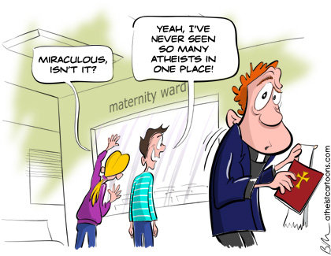

Slide 3
Relevance to Education
http://www.youtube.com/watch?v=qyHI2foecLI&feature=PlayList&p=7ADD45A2C9B4F191&index=0
Video from above link inserted here.
(Why we must respect religious ideas answered at end of presentation.)

Slide 4
Mixed Bag
Protestants
Lib Protestants
Con Protestants
Evangelicals
Fundamentalists
Born Agains
Moral Majority
Creation Science
Intelligent Design
Young Earthers
Old Earthers
Catholics
Charismatic's
Jews
Kabala's
Muslims
Shiites
Sunnis
Black Muslims
Buddhists
Hindus
Latter Day Saints
7th Day Adventists
Eastern Orthodoxy
Christian Scintsts
Native Americans
Jainists
Sikhs
Baha'is
New Agers
Wiccans
Cults
Scientologists
Moonies
Pastafarians

Slide 5
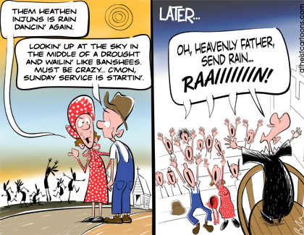

Slide 6
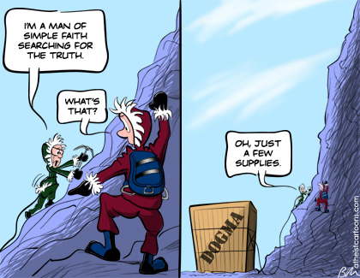
Contrasts
Religious
Philosophical
Doctrinal
Dogmatic
Educational
Political
Gender

Slide 7
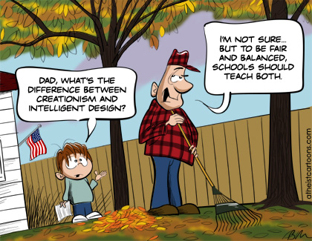
Effects on Education
Religionists form determined lobby groups.
Kansas

Slide 8
Political Influence

Slide 9
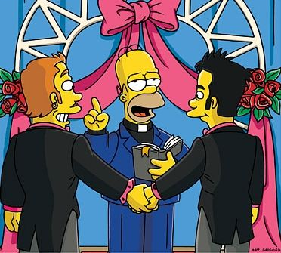
Big Ticket Items

Slide 10
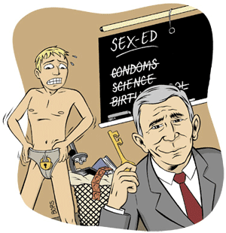
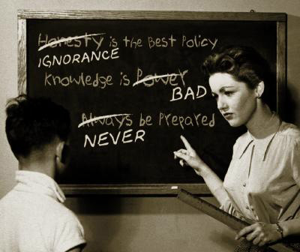
Sex Education

Slide 11
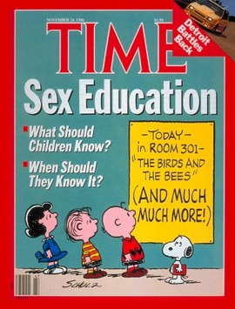

Slide 12
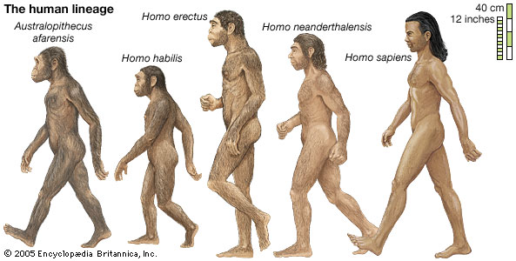
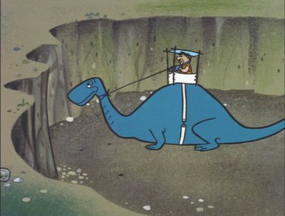
Evolution

Slide 13

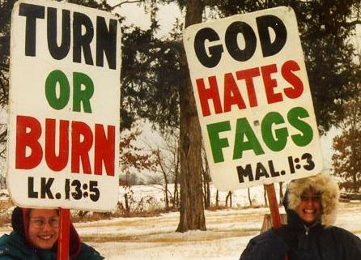
Lifestyles

Slide 14
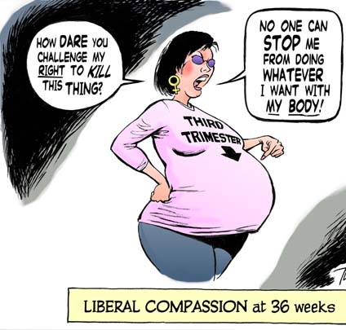
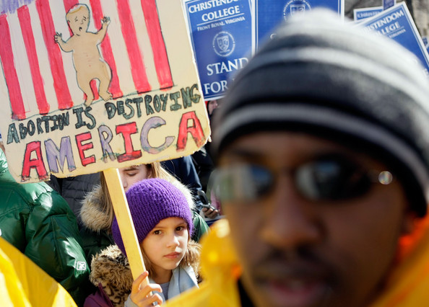
Abortion

Slide 15
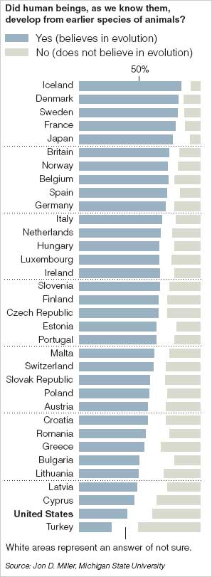

Up hill battle

Slide 16

Anti Semitism
Jews are apes and pigs (from the Koran)
Holocaust denial

Slide 17
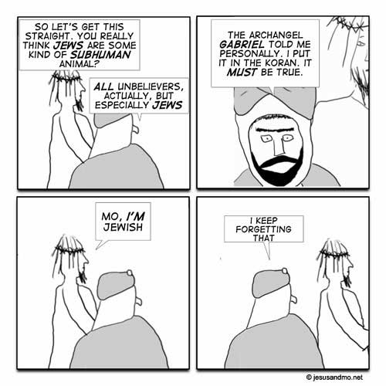

Slide 18
Hate Speech
“Muslims are the vilest of animals…”
“Show mercy to one another, but be ruthless to Muslims”
“How perverse are Muslims!”
“Strike off the heads of Muslims, as well as their fingertips”
“Fight those Muslims who are near to you”
“Muslim mischief makers should be murdered or crucified”

Slide 19
The Koran
Revelations from Allah, through AA Michael to Mohammad
Not chronological. Longer to shorter sura (verses).
The word of Allah, not Mohammad
The immutable word of Allah.

Slide 20
The Sunnah
The “way” of Mohammad
Comes from the hadiths: Reports on Mohammad’s life.
Mohammad: the perfect man. Not divine, but ideal example. If Mohammad did it, it’s okay. He is the measuring stick by which morality is judged.

Slide 21
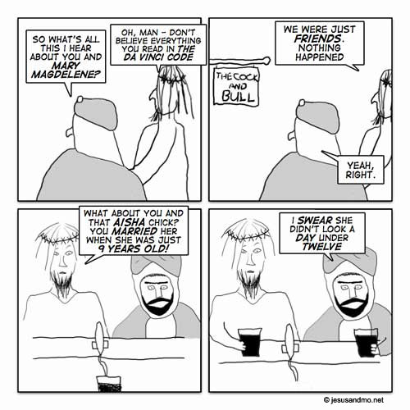
The Sira
The 8th Century biography of Mohammad. Recall that Mohammad is the perfect example.

Slide 22
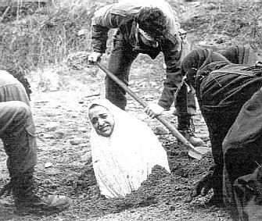
Sharia Law
Sharia means the way or path
Legal code ordained by Allah for all mankind: not optional
Derived from Koran , Sunnah, Sira

Slide 23
What does this mean?
Marriage: girls 9
Female testimony worth ½ that of male
Rape: need 4 male witnesses
Inheritance laws: ½ that of male
Wives may not refuse husbands sex
Husbands may beat wives

Slide 24
Doctrine of Abrogation
Conflicting verses
The abrogating verse is the more recent verse
Peaceful verses (older) abrogated by belligerent (more recent) verses.

Slide 25
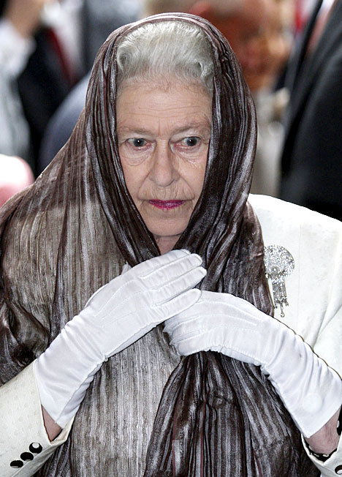
Dhimmi
Refers to non muslim’s status under sharia law.
Based on Koran, must “feel subdued”
Dhimmis denied rights & dignity
Pay jizya

Slide 26
Doctrine of Taqiyya & Kitman
Taqiyya: Saying something untrue
Kitman: Lying by omission
to gain the trust of non-believers in order to draw out their vulnerability and defeat them
“There is no compulsion in Islam”
(abrogated)

Slide 27


Slide 28
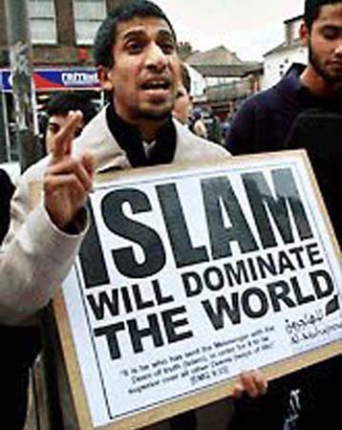
Jihad
Means “struggle”
Does not mean “holy war”
Inner spiritual struggle (smoking)
Outward physical struggle (cleaning a mosque)
Recall taqiyya and kitman
All major schools of Islamic scholarship teach that Muslims must fight against the infidel.

Slide 29
Forced Conversion
Muslims are commanded to fight non-believers until non-believer is :
Dead
Converted to Islam
State of submission, paying jizya

Slide 30
ARAB / ISLAMIC NOBEL WINNERS
From a pool of 1.4 BILLION Muslims
20% of World's Population
(2 out of every 10 people)
Literature
1988 - Najib Mahfooz *
2006 - Orhan Pamuk
Peace
1978 - Anwar El-Sadat
1994 - Yasser Arafat
2003 - Shirin Ebadi
2005 - Mohamed ElBaradei
2006 - Muhammad Yunus
Chemistry
1999 - Ahmed Zewail
Physics
1979 - Abdus Salam
.
.
.
.
.
.
.
.
JEWISH NOBEL WINNERS
From a pool of 12 million Jews
0.2% of the World's Population
(2 out of every 1,000 people)
Literature
1910 - Paul Heyse
1927 - Henri Bergson
1958 - Boris Pasternak
1966 - Shmuel Yosef Agnon
1966 - Nelly Sachs
1976 - Saul Bellow
1978 - Isaac Bashevis Singer
1981 - Elias Canetti
1987 - Joseph Brodsky
1991 - Nadine Gordimer
2002 - Imre Kertesz
2005 - Harold Pinter
World Peace
1911 - Alfred Fried
1911 - Tobias Asser
1968 - Rene Cassin
1973 - Henry Kissinger
1978 - Menachem Begin
1986 - Elie Wiesel
1994 - Shimon Peres
1994 - Yitzhak Rabin
1995 - Joseph Rotblat
Chemistry
1905 - Adolph Von Baeyer
1906 - Henri Moissan
1910 - Otto Wallach
1915 - Richard Willstaetter
1918 - Fritz Haber
1943 - George Charles de Hevesy
1961 - Melvin Calvin
1962 - Max Ferdinand Perutz
1972 - William Howard Stein
1972 - C.B. Anfinsen
1977 - Ilya Prigogine
1979 - Herbert Charles Brown
1980 - Paul Berg
1980 - Walter Gilbert
1981 - Ronald Hoffmann
1982 - Aaron Klug
1985 - Herbert A. Hauptman
1985 - Jerome Karle
1986 - Dudley R. Herschbach
1988 - Robert Huber
1989 - Sidney Altman
1992 - Rudolph Marcus
1998 - Walter Kohn
2000 - Alan J. Heeger
2004 - Irwin Rose
2004 - Avram Hershko
2004 - Aaron Ciechanover
2006 - Roger D. Kornberg
2008 - Martin Chalfie
Economics
1970 - Paul Anthony Samuelson
1971 - Simon Kuznets
1972 - Kenneth Joseph Arrow
1973 - Wassily Leontief
1975 - Leonid Kantorovich
1976 - Milton Friedman
1978 - Herbert A. Simon
1980 - Lawrence Robert Klein
1985 - Franco Modigliani
1987 - Robert M. Solow
1990 - Harry Markowitz
1990 - Merton Miller
1992 - Gary Becker
1993 Rober Fogel
1994 - John Harsanyi
1994 - Reinhard Selten
1997 - Robert Merton
1997 - Myron Scholes
2001 - George Akerlof
2001 - Joseph Stiglitz
2002 - Daniel Kahneman
2004 - Richard Axel
2005 - Robert J. Aumann
2006 - Andrew Z. Fire
2007 - Leonid (Leo) Hurwicz
2007 - Eric Maskin
2007 - Roger Myerson
2008 - Paul Krugman
Physiology / Medicine
1908 - Elie Metchnikoff
1908 - Paul Erlich
1914 - Robert Barany
1922 - Otto Meyerhof
1930 - Karl Landsteiner
1931 - Otto Warburg
1936 - Otto Loewi
1944 - Joseph Erlanger
1944 - Herbert Spencer Gasser
1945 - Ernst Boris Chain
1946 - Hermann Joseph Muller
1947 - Garty Cori
1950 - Tadeus Reichstein
1952 - Selman Abraham Waksman
1953 - Hans Krebs
1953 - Fritz Albert Lipmann
1958 - Joshua Lederberg
1959 - Arthur Kornberg (father)
1964 - Konrad Bloch
1965 - Francois Jacob
1965 - Andre Lwoff
1967 - George Wald
1968 - Marshall W. Nirenberg
1969 - Salvador Luria
1970 - Julius Axelrod
1970 - Sir Bernard Katz
1972 - Gerald Maurice Edelman
1975 - David Baltimore
1975 - Howard Martin Temin
1976 - Baruch S. Blumberg
1977 - Rosalyn Sussman Yalow
1977 - Andrew V. Schally
1978 - Daniel Nathans
1980 - Baruj Benacerraf
1982 - [Sir] John Vane
1984 - Cesar Milstein
1985 - Michael Stuart Brown
1985 - Joseph L. Goldstein
1986 - Rita Levi-Montalcini
1986 - Stanley Cohen [& Rita Levi-Montalcini]
1988 - Gertrude Elion
1989 - Harold Varmus
1991 - Erwin Neher
1991 - Bert Sakmann
1992 - Edmond Fischer
1993 - Richard J. Roberts
1993 - Phillip Sharp
1994 - Alfred Gilman
1994 - Martin Rodbell
1995 - Edward B. Lewis
1997 - Stanley B. Prusiner
1998 - Robert F. Furchgott
2000 - Eric R. Kandel
2000 - Paul Greengard
2002 - Sydney Brenner
2002 - Robert H. Horvitz
2006 - Roger Kornberg (son)
2006 - Andrew Z. Fire
Physics
1907 - Albert Abraham Michelson
1908 - Gabriel Lippmann
1921 - Albert Einstein
1922 - Niels Bohr
1925 - James Franck
1925 - Gustav Hertz
1943 - Gustav Stern
1944 - Isidor Issac Rabi
1945 - Wolfgang Pauli
1952 - Felix Bloch
1954 - Max Born
1958 - Igor Tamm
1958 - Il'ja Mikhailovich
1958 - Igor Yevgenyevich
1959 - Emilio Segre
1960 - Donald A. Glaser
1961 - Robert Hofstadter
1962 - Lev Davidovich Landau
1963 - Eugene P. Wigner
1965 - Richard Phillips Feynman
1965 - Julian Schwinger
1967 - Hans Albrecht Bethe
1969 - Murray Gell-Mann
1971 - Dennis Gabor
1972 - Leon N. Cooper
1973 - Brian David Josephson
1975 - Benjamin Mottleson
1976 - Burton Richter
1978 - Arno Allan Penzias
1978 - Peter L Kapitza
1979 - Stephen Weinberg
1979 - Sheldon Glashow
1988 - Leon Lederman
1988 - Melvin Schwartz
1988 - Jack Steinberger
1990 - Jerome Friedman
1992 - Georges Charpak
1995 - Martin Perl
1995 - Frederick Reines
1996 - David M. Lee
1996 - Douglas D. Osheroff
1997 - Claude Cohen-Tannoudji
2000 - Zhores I. Alferov
2003 - Vitaly Ginsburg
2003 - Alexei Abrikosov
2004 - David Gross
2004 - H. David Politzer
2005 - Roy Glauber
184
9

Slide 31
Numbers
More people are killed by Islamists each year than in all 350 years of the Spanish Inquisition combined.
More civilians were killed by Muslim extremists in two hours on September 11th than in the 36 years of sectarian conflict in Northern Ireland.

Slide 32
Hate Speech (from the Koran)
“Disbelievers are the vilest of animals…”
“Show mercy to (Muslims), but be ruthless to unbelievers”
“How perverse are Jews!”
“Strike off the heads of disbelievers, as well as their fingertips”
“Fight those unbelievers who are near to you”
“Unbeliever mischief makers should be murdered or crucified”

Slide 33
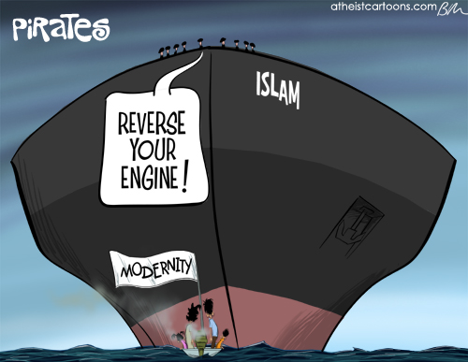
Moderate
There are moderate Muslims
Moderate Islam… not so much.

Slide 34
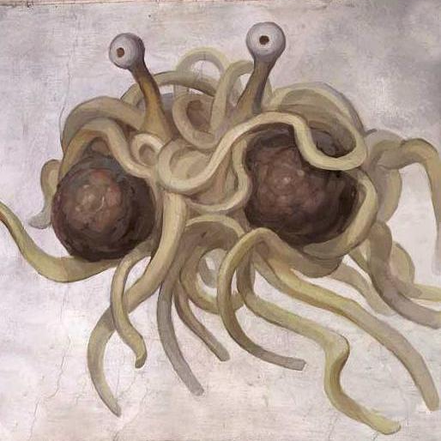
Pastafarians
Universe created by the Flying Spaghetti Monster.
Several holy books say so.
10 million world-wide

Slide 35
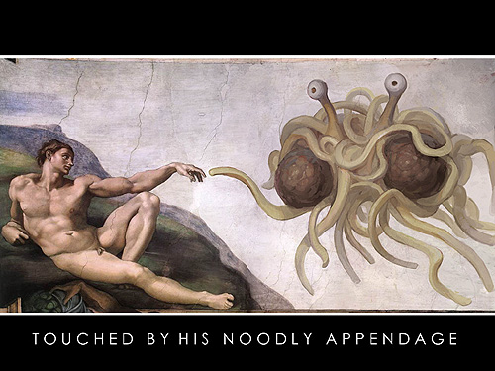

Slide 36
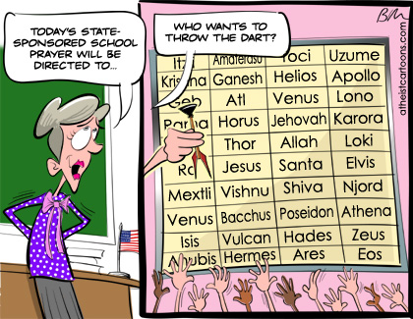
School Prayer
Praying privately in school is okay.
No school sanctioned prayer or invocation.

Slide 37

School Vouchers
Voucher system would subsidize sending kids to private (religious) schools.
Takes $ away from public system.

Slide 38
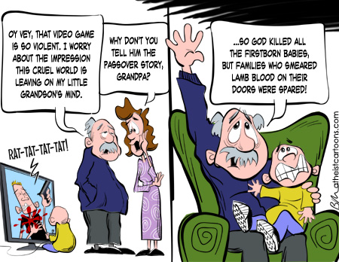
Censorship
Both sides have firm convictions.
Go with the flow.
You’re # 1

Slide 39
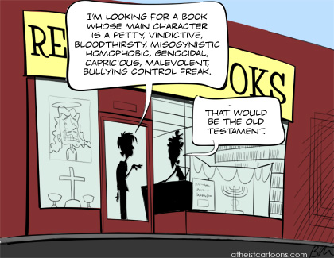

Slide 40
Freedom of Speech
U.S. 1st Amendment
Canada: Charter of Rights and Freedoms

Slide 41
Canadian Human Rights Act
Section 13.1
Illegal to communicate anything “that is likely to expose a person or persons to hatred or contempt”
A future thought crime.

Slide 42
Human Rights Commissions
Provincial & Federal
Kangaroo court
Double jeopardy
Truth is not a defense
Search and seizure with out warrant
Often non lawyers
100% conviction rate (Section 13.1)
Government censorship

Slide 43
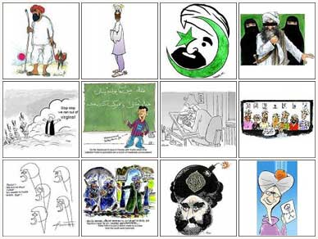

Slide 44

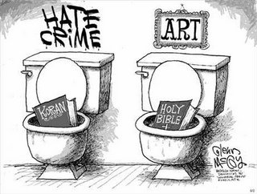

Slide 45
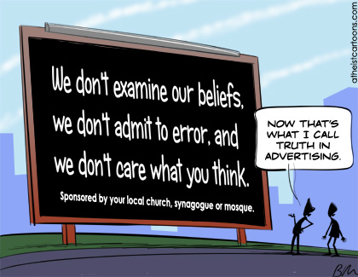
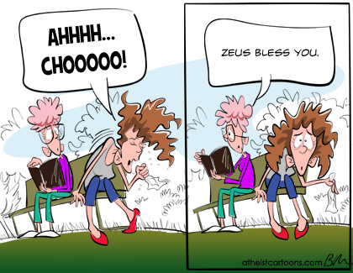

Slide 46
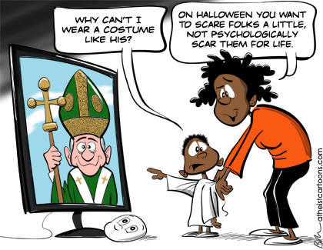

Slide 47
