Slide 1
Running Records
Stacey Dahmer
Dana Grant

Slide 2
What is a running record?
An assessment tool
To assess a student’s oral reading proficiency
Used in early stages of literacy development\
May be used with older students with reading difficulty
RR are one of the 3 key elements of the diagnostic procedure – RR, Retelling, Questions to check for understanding

Slide 3
RR provide an opportunity to observe children's difficulties in self-monitoring and self-correcting
Should be implemented by the end of the first year with all children
At least with the lowest 50% of learners

Slide 4
In a nutshell:
Running records show what a student said and did while reading a specific text

Slide 5
Pros
RR can identify approaches to reading that are not readily identifiable by other means of assessment
They can provide early intervention
They are quick and can be done within the classroom

Slide 6
Cons
RR can be subjective and rely too heavily on the accuracy of the administrator recording the notes
Can decrease the reliability of the assessment
Calculating the results can be time consuming
Take practice to administer

Slide 7
Use RR to inform your teaching
Help select appropriate level texts
Monitor student progress
Plan for instruction
Communicate information

Slide 8
Results of Running Records
Determines the % Accuracy Rate
Determines the Self Correction Ratio (SC)

Slide 9
% Accuracy Rate
Independent level ≥ 95%
Instructional level 90-94%
Frustration level < 90%

Slide 10
SC Ratio (MSV)
Shows insight into student’s reading process
A proficient reader will watch for words that do not make sense (M), do not sound according to their structure (S) or do not look right (V visual) and then go back to try to make everything match.

Slide 11
Understanding SC Ratio
Good
1:2 student self corrects every miscue
1:3 student self corrects ½ of miscues
1:4 student self corrects 1/3 of miscues
1:5 student self corrects ¼ of miscues
1:6 student self corrects 1/5 of miscues
1:7 student self corrects 1/6 of miscues
1:8 student self corrects 1/7 of miscues
Bad

Slide 12
A SC ratio of 1:4 or better, indicates student is effective in noticing errors
1:5 (6,7,8…) or greater is bad.
(If student makes no errors, there will be no SC ratio.)

Slide 13
Taking a Running Record
Quick
Passages 100-200 words
The hardest part is the shorthand conventions and MSV analysis – practice!

Slide 14
Shorthand Conventions
General Rule
What student says Student action
What is written Teacher action

Slide 15
Conventions: Accurate Reading
Each word read correctly is scored with a ✓
✓✓✓✓

Slide 16
Conventions: Substitution
If the student reads a word incorrectly, teacher writes the incorrect word and the correct word under it. (Each example is scored as only 1 error)
take take took
taken taken

Slide 17
Conventions: Self Corrections (SC)
If the student self corrects an error, teacher writes “SC” following the incorrect word. Not counted as an error.
take SC
taken

Slide 18
Conventions: Repetition (R)
Not counted as errors
Student: Jarrett ran to to the store
Text: Jarrett ran to the store
✓ ✓ ✓ R ✓ ✓

Slide 19
Conventions: Omission
Counted as an error
Student: Jarrett was ------- to jail.
Text: Jarrett was taken to jail.
✓ ✓ ___ ✓ ✓
taken

Slide 20
Conventions: Insertion
Counted as an error
Student: There is a little bug in Jarrett’s ear
Text: There is a bug in Jarrett’s ear
✓ ✓ ✓ little ✓ ✓ ✓ ✓
___

Slide 21
Conventions: Appeal (A)
Not counted as an error
Sometimes Jarrett eats worms
___ A SC ✓ ✓ ✓
sometimes Y
Teacher response to appeal: “You try it”

Slide 22
Conventions: Told (T)
Counted as an error
___
sometimes T

Slide 23
Conventions: Try That Again (TTA)
Counted as an error
[ ] TTA

Slide 24
Conventions: Sounding Out Words
Use lowercase and dashes
c-a-t error: Student did not say the word
cat
c-a-t cat not an error: Student blended the
cat sounds and said the word

Slide 25
Conventions: Spelling the Word
Use UPPERCASE and dashes
C-A-T error: Student did not say the word
cat
C-A-T cat not an error: Student spells then
cat says the word

Slide 26
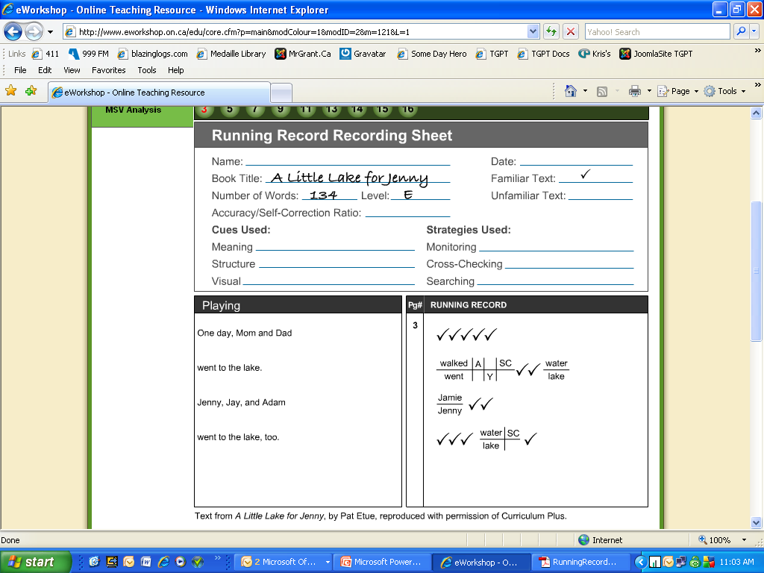
Recording Examples

Slide 27
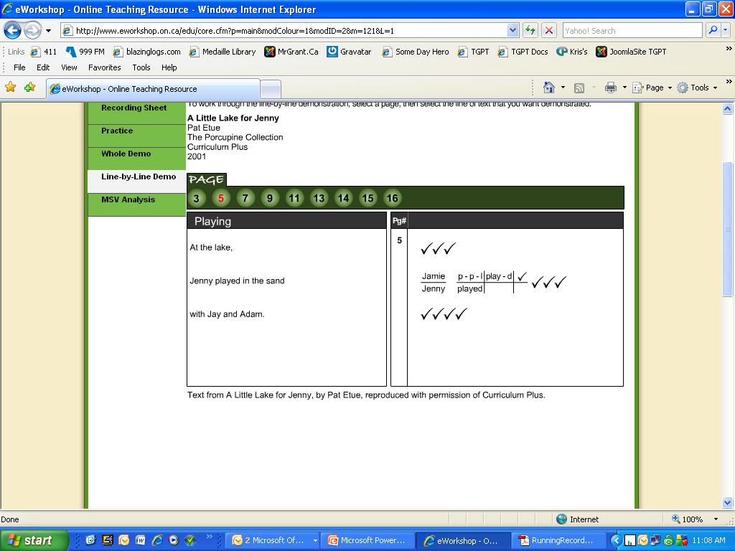

Slide 28
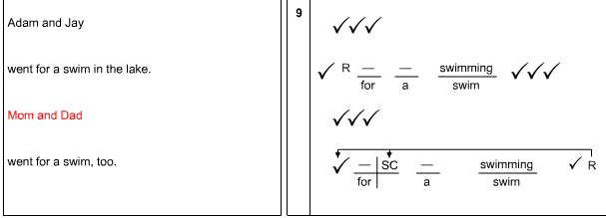

Slide 29
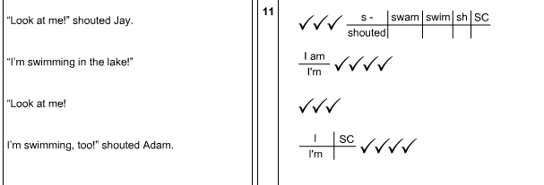

Slide 30
Scoring a Running Record
You need to calculate the % Accuracy
Determine the Self Correction Ratio

Slide 31
Calculating % Accuracy
Count total running words (RW)
Count total # of errors (E)
# Words Correct (RW – E) x 100 = % Accuracy
# of Words RW

Slide 32
Example: % Accuracy
Running Words (RW) = 167
Total Errors (E) = 10
167 – 10 x 100 = 94% accuracy
167

Slide 33
Calculating Self Correction Ratio
Errors: Count them up (E)
Self corrections: Count them up (SC)
E + SC = SC Ratio
SC
Record in the form of 1 : x

Slide 34
Example: SC Ratio
E = 10
SC = 4
10 + 4 = 3.5
4
SC Ratio is 1 : 3.5
(If student makes no errors, there is no SC ratio)

Slide 35
Interpreting the Running Record
Each error and self-correction helps you see why the student read the text a certain way.
What strategies are successful, what needs to be introduced or reinforced.
What reading behaviors are interfering with the student's reading process.

Slide 36
Error Analysis: M – S – V
Does the miscue change the meaning of the text? (M)
Does the miscue have a similar sound & structure to the text? (S)
Does the miscue look similar to the text? (V)
Miscues occur when the student uses the wrong cueing system to figure out the word

Slide 37
Self Correction Analysis: M – S – V
Does the reader SC the miscue?
What information did the student use to self correct? Meaning, Sound & Structure, Visual?
Does the miscue change the meaning of the sentence?
Is the miscue phonologically similar to the word in the text?
Is the miscue acceptable within the syntax (structure) of the sentence?

Slide 38
Meaning
“Does it make sense?”
Even if the reading is inaccurate , if it makes sense the child is using their knowledge of ORAL LANGUAGE
Grammatical errors can be an indication of the child’s vocabulary.
Are they reading the way they speak?

Slide 39
Structure
“Does it sound right?”
Is it grammatically correct?

Slide 40
Visual
“Does it look right?”

Slide 41
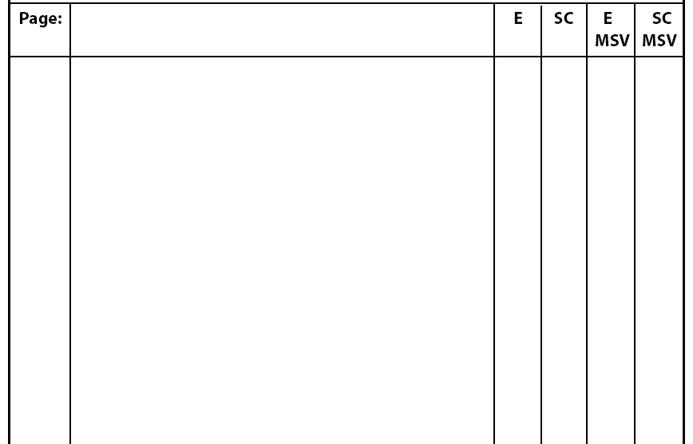
Recording Sheet
Errors
Self corrections
Analysis of errors
Analysis of self corrections

Slide 42
Reading Strategies
SEARCHING | MONITORING | CROSSCHECKING
Child uses the available information to solve a word | Ensures reading makes sense semantically, syntactically, and visually | For example: child says ran instead of walk
Picture | Proficient readers stop and check all 3 sources | M – does not change
Used initial sound | Paused at errors | S - does not change / sounds OK
Covered ending | Repeated phrases after error | V – does not match
Found chunks | Appealed for confirmation after error | Used V to check MS
Read on |  | Used MS to check V

Slide 43
Teaching Strategies to Use
Analysis | Response | Instructional Approaches
Uses 1-2 sources of information | Direct teaching to the omitted source | Guided Reading Shared Reading
Uses MS but neglects V | Direct teaching to focus on visual information | Effective ways to solve words – chunking, initial sound, repeating and attempting new words
Does not address punctuation and text features | Model Provide opportunities | Model during Read Aloud and writing sessions Shared reading/writing activities Emphasize punctuation

Slide 44
Teaching Strategies to Use
Analysis | Response | Instructional Approaches
Substitutions Omissions Insertions | Emphasize attention to visual information | Pictures Text formation | Provide comprehension strategies “Does that make sense?”
Neglects meaning (focus on V) | Direct teaching Teach pre-reading comprehension strategies | Reread Predict Picture walk Check | Questioning Make connections
Rarely self-corrects | Teach self-monitoring | Check MSV Provide checking strategies | Use Guided Reading and Shared reading sessions to model

Slide 45
Teaching Strategies to Use
Analysis | Response | Instructional Approaches
Reads slowly word for word | Read books – focus on fluency not decoding | Model Use choral reading Books on audiotape | Use patterned text, songbooks, rhymes High interest
Struggles with high frequency words | Create word banks, word wall | Emphasize words in shared writing
Invents text | Finger pointing - | 1:1 print concept

