Slide 1
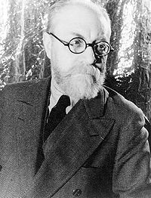
Henri Matisse 1869-1954

Slide 2
Henri Matisse
French
One of the greatest artists of the 20th Century
Initially studied law in Paris but then discovered art
Initially painted still life and landscapes
Had a fondness for bright and expressive colours

Slide 3
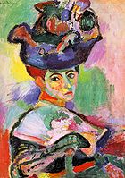
Woman in Hat (1905)

Slide 4
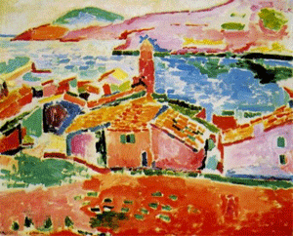
Les toits de Collioure (1905)

Slide 5
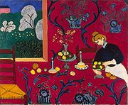
The Desert Harmony in Red (1905)

Slide 6
Matisse did the bulk of his painting in the early part of the 20th Century.
Because of poor health as he aged, he was unable to continue painting and started creating art in a whole new style.
He experimented with cutouts using bright colours and shapes.

Slide 7
Collage
A collage is a form of art in which shapes are cut out and stuck to a background to create a picture.
While Matisse’s paintings were fairly realistic, his collages became quite abstract.

Slide 8
Some of Matisses’ collages.

Slide 9
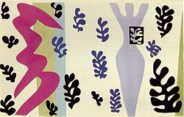
The Knife Thrower (1947)

Slide 10
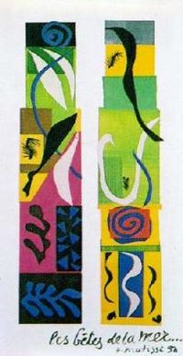
Beasts of the Sea (1950)

Slide 11
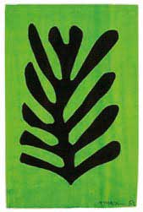
Black leaf on Green Background (1952)

Slide 12
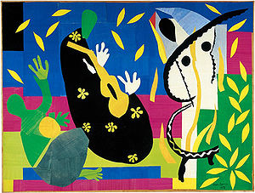
The Sorrows of the King (1952)

Slide 13
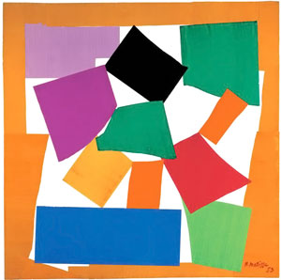
The Snail (1953)

Slide 14
Today’s Project
Cut out square and rectangle shapes of different sizes and glue them onto a sheet of paper (overlapping is okay) to create a background.
Cut out some irregular shapes (like people, objects, stars, trees, buildings etc.) and glue them onto your background.
Cut out a number of smaller shapes that show motion, or attract your eye.

